Slide 1
Business Process – Accounts Payable

Slide 2
Accounts Payable Stakeholder Wheel 1.0
Finance Manager
Finance Analyst
Department Analyst
Department Manager
Supplier
Stakeholder Wheel

Slide 3
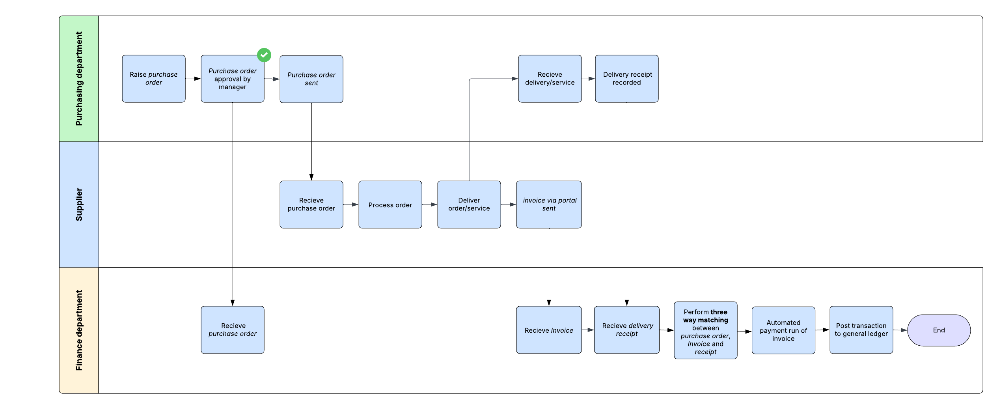
Accounts Payable Business Process Diagram 1.1

Slide 4
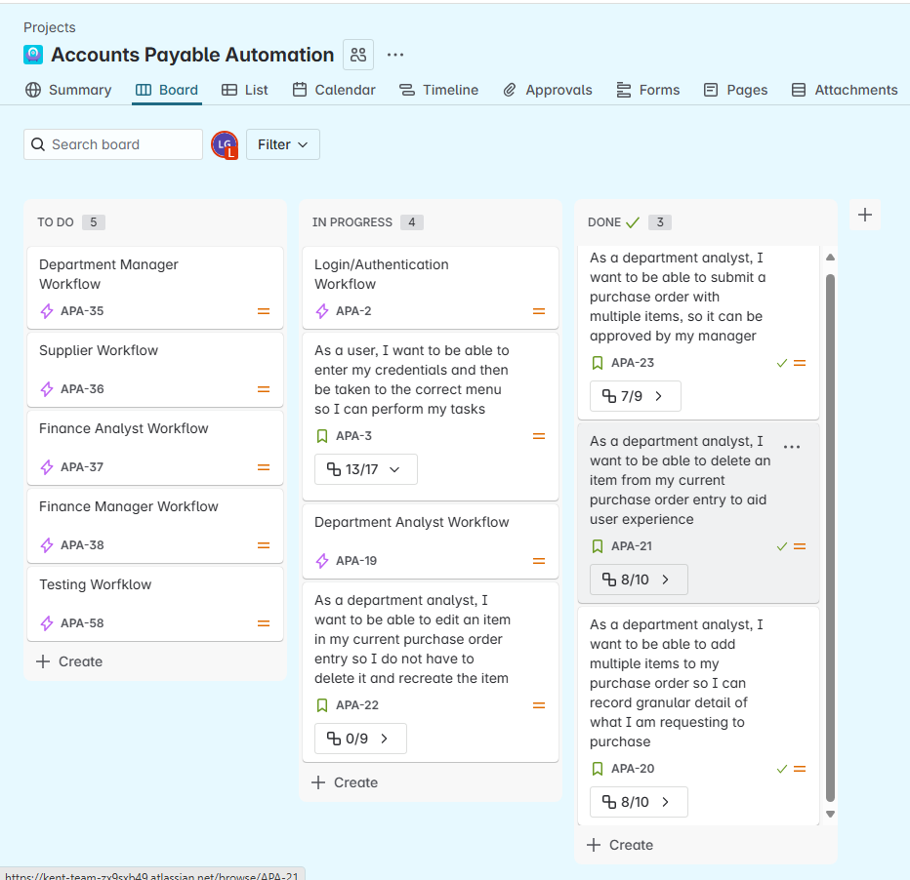
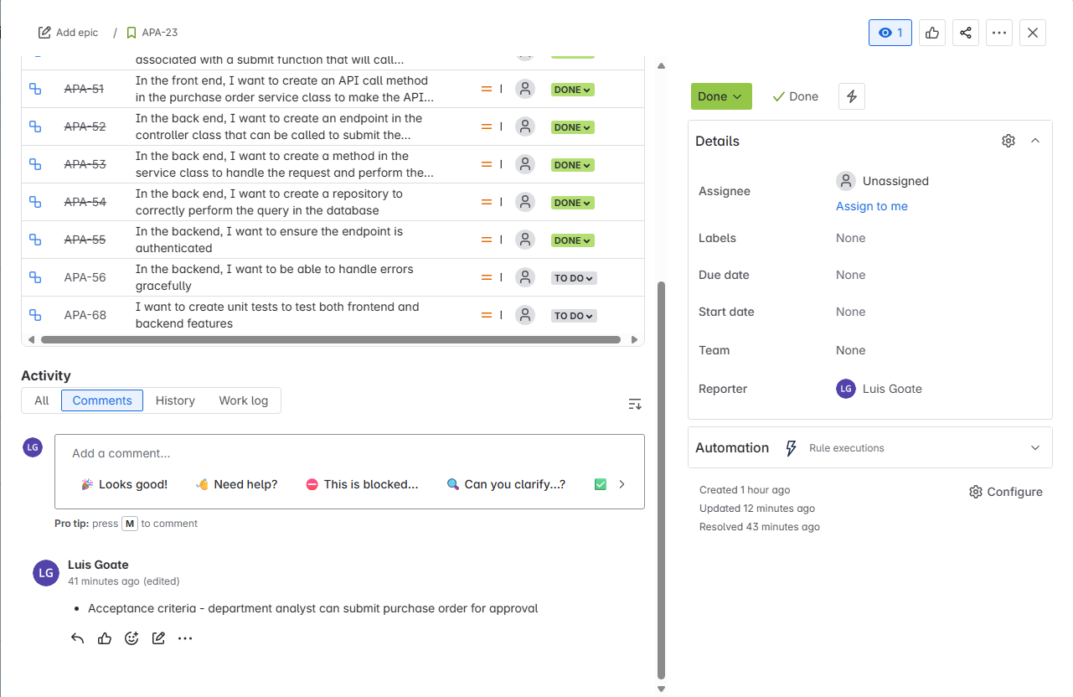





Accounts Payable User Stories 1.0
Board - Accounts Payable Automation - Jira

Slide 5
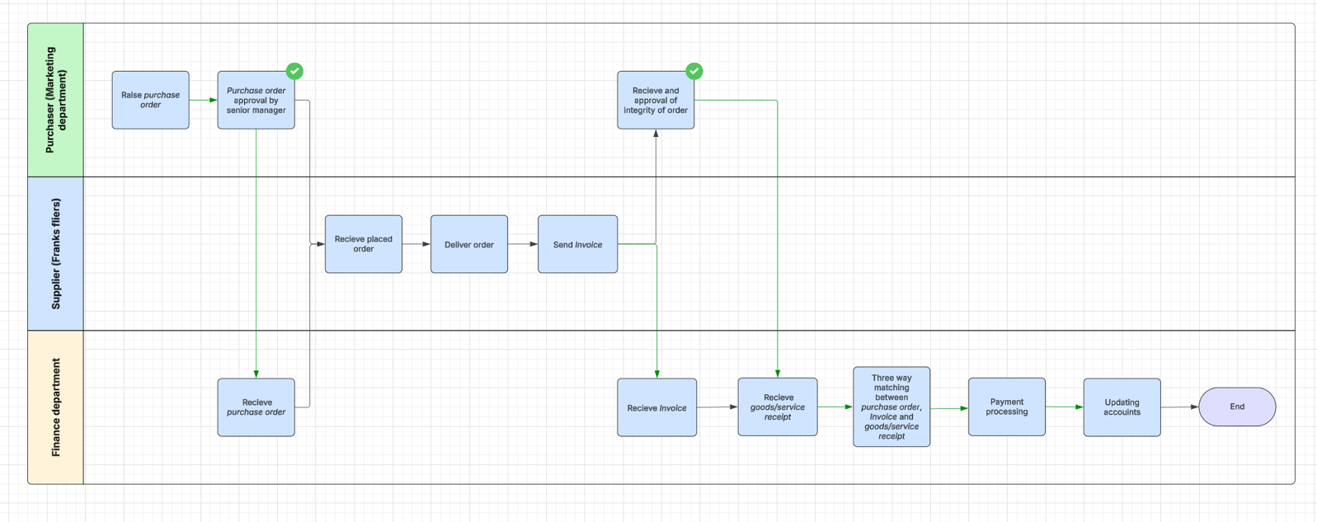
Accounts Payable Business Process 1.0

Slide 6
System Design

Slide 7
Component Diagram

Slide 8
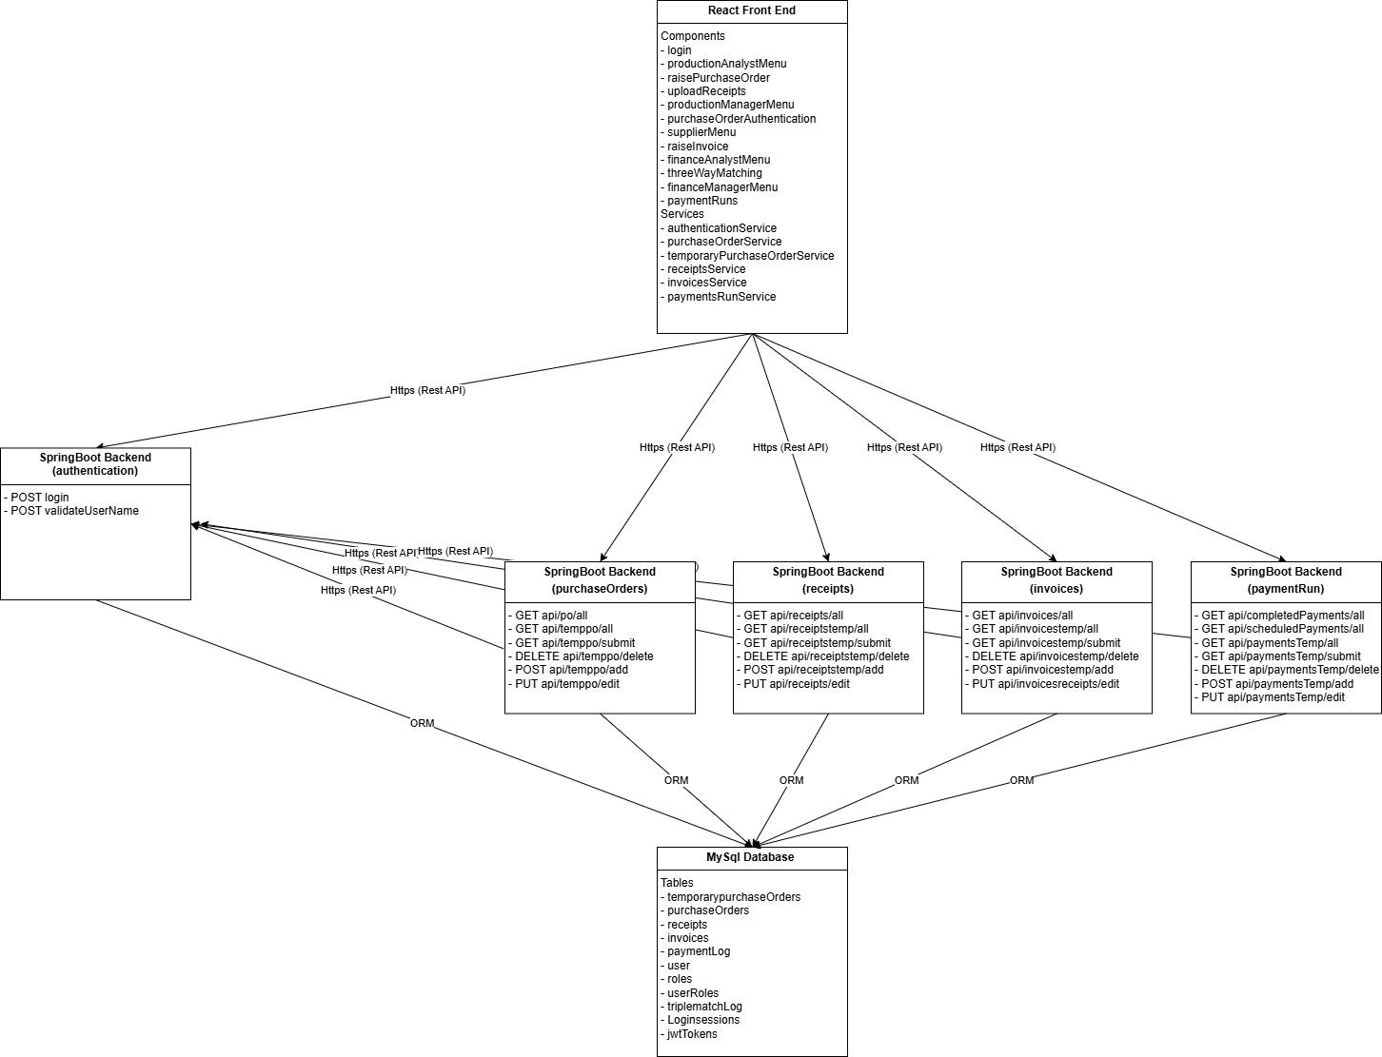
Web Application Component Diagram 1.0

Slide 9
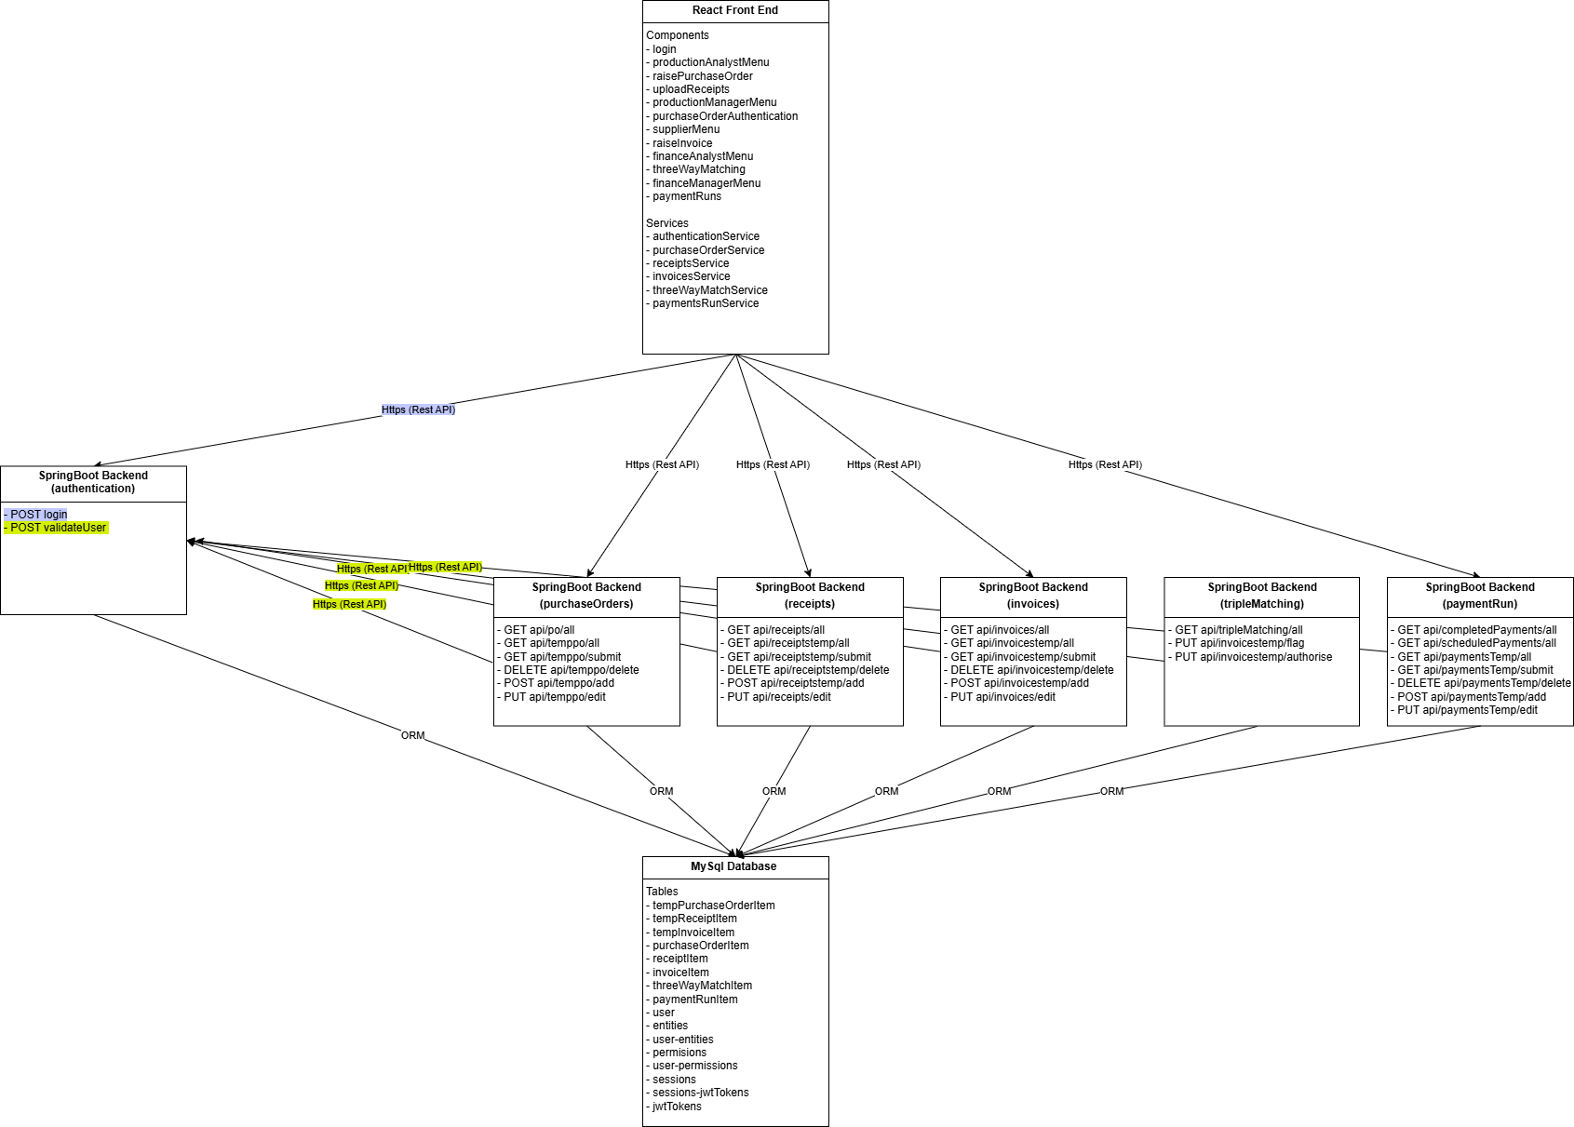
Web Application Component Diagram 1.1

Slide 10
REST API Sequence Diagram

Slide 11
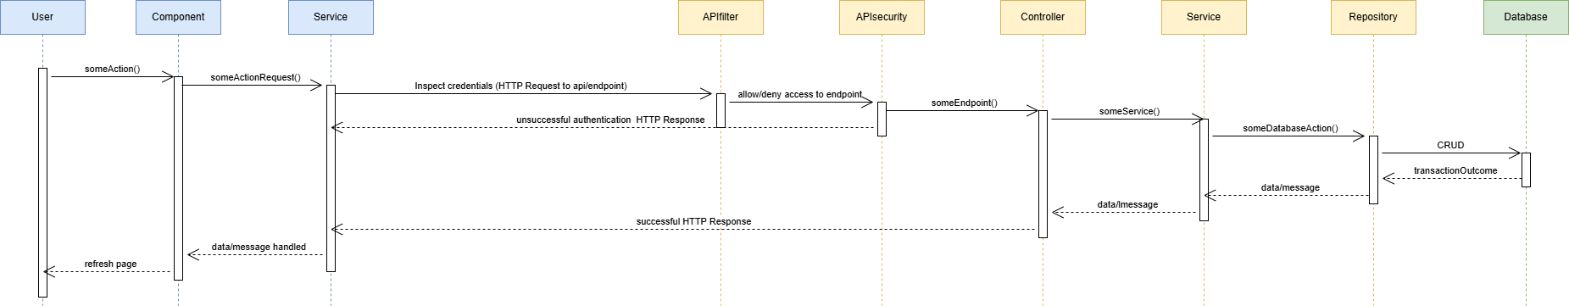
API Sequence Diagram – Basic Sequence
As of web application component diagram 1.1, there are 30 REST API endpoints across 6 microservices
28 of the requests will follow a similar pattern
Front end
Back end
Database

Slide 12
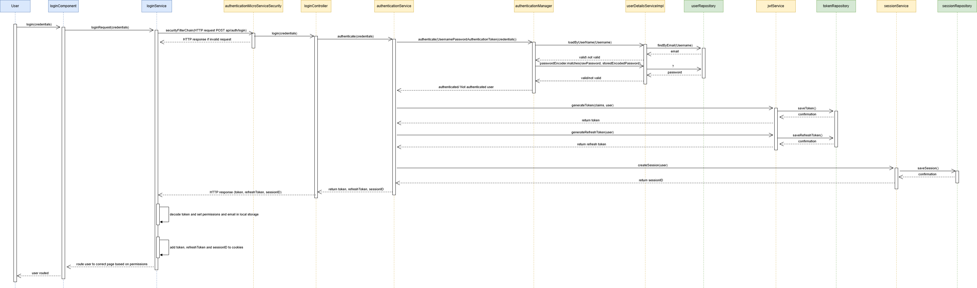
API Sequence Diagram – Authentication Request
Front end
Back end
Database

Slide 13
Database Design

Slide 14
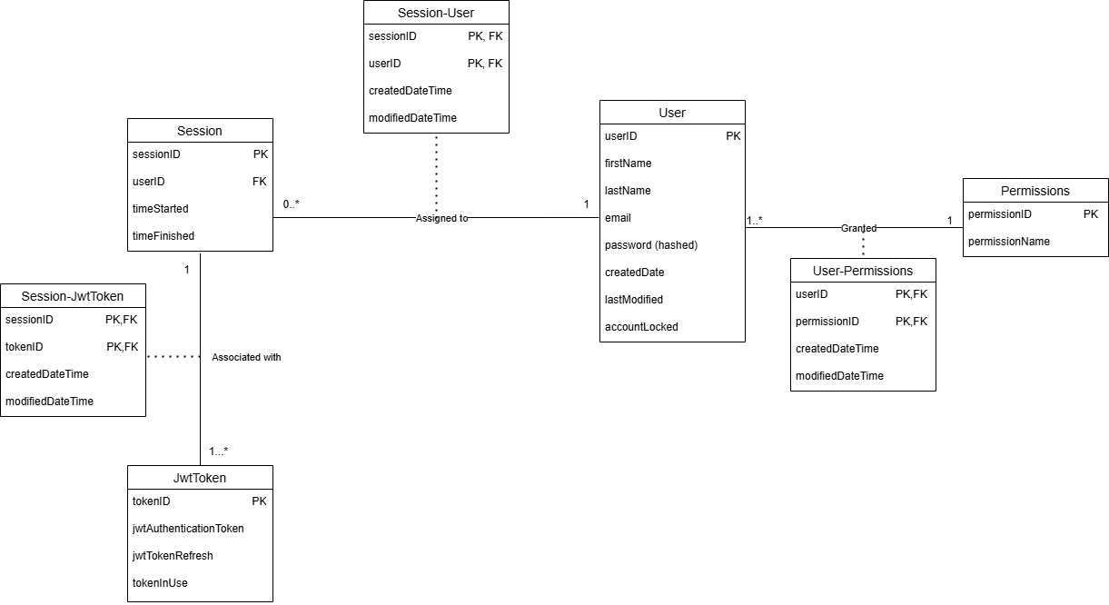
Database Design Diagram – Authentication 1.0

Slide 15
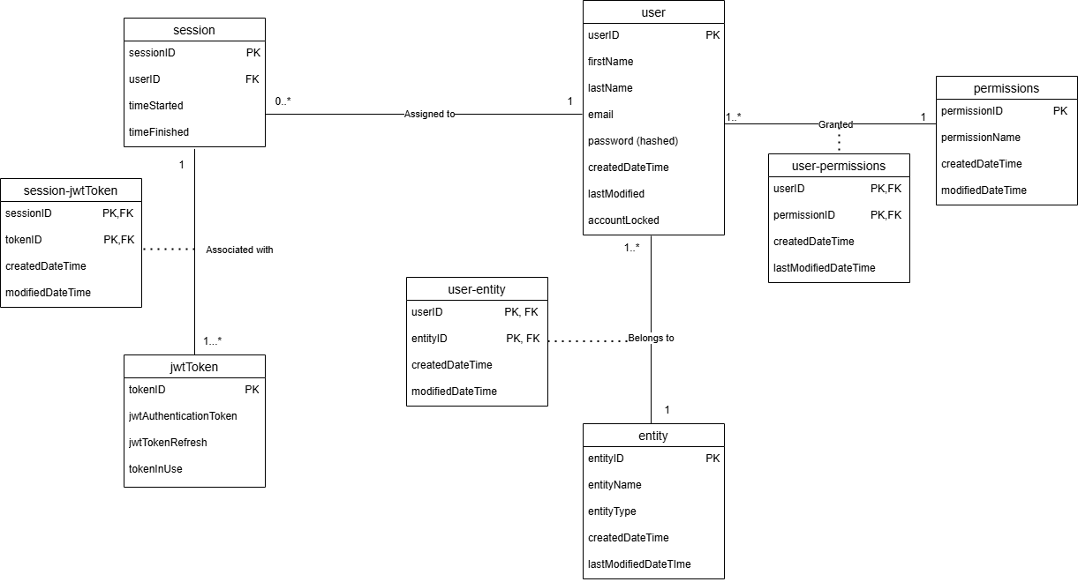
Relational/Conceptual Model – Authentication 1.1

Slide 16
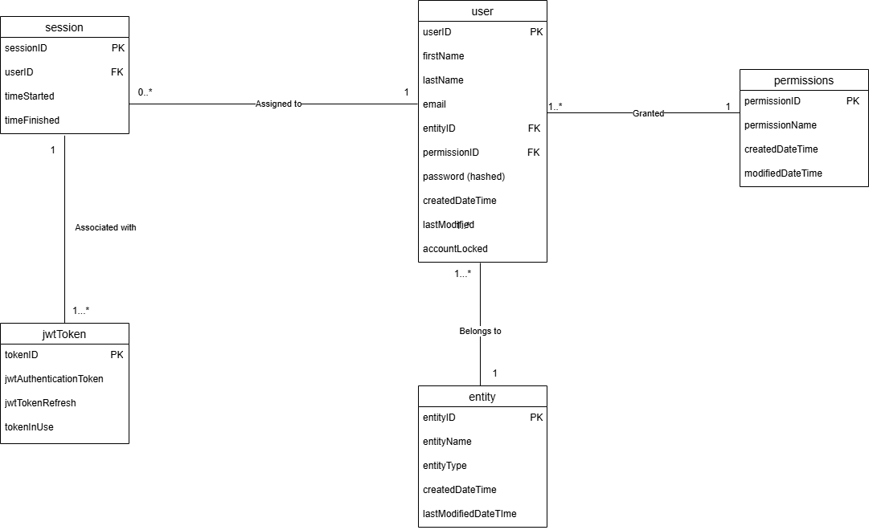
Relational/Conceptual Model – Authentication 1.2

Slide 17
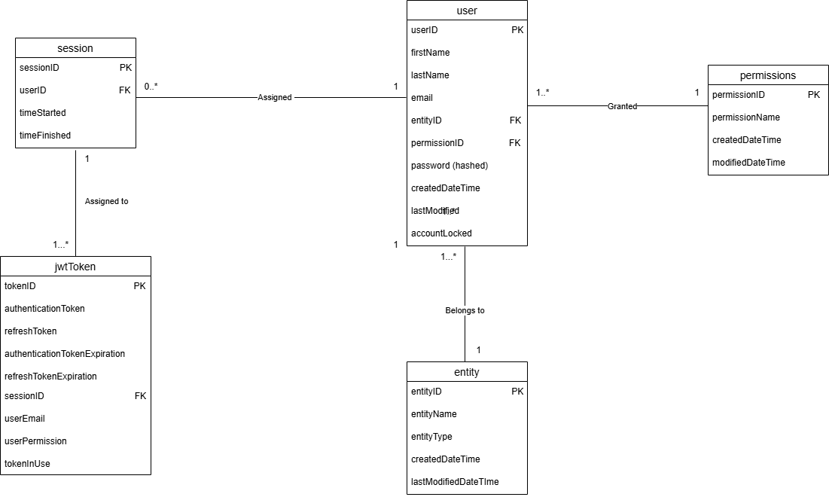
Relational/Conceptual Model – Authentication 1.3

Slide 18
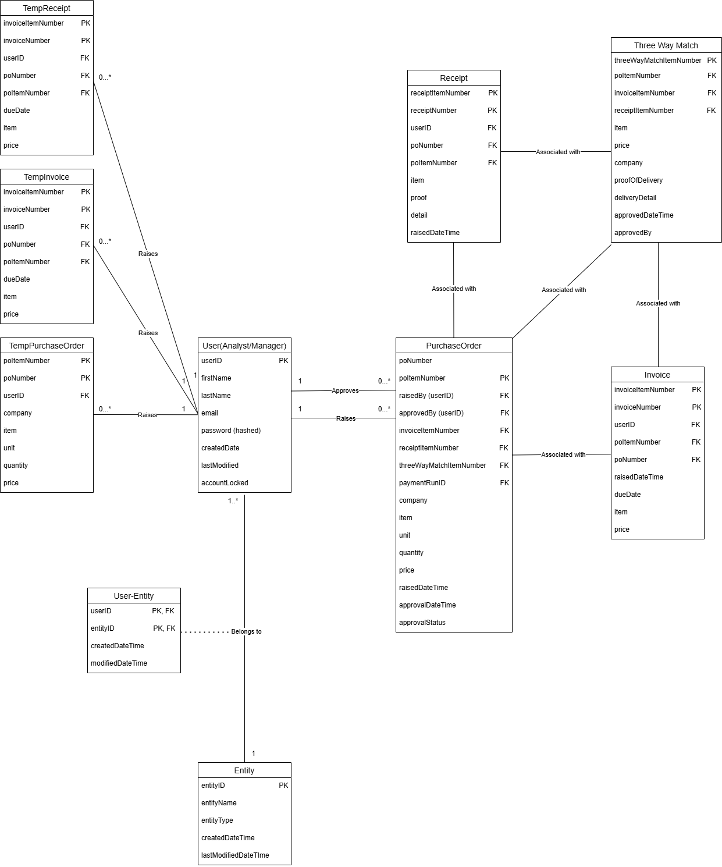
Database Design Diagram – Overall Attempt 1.0

Slide 19
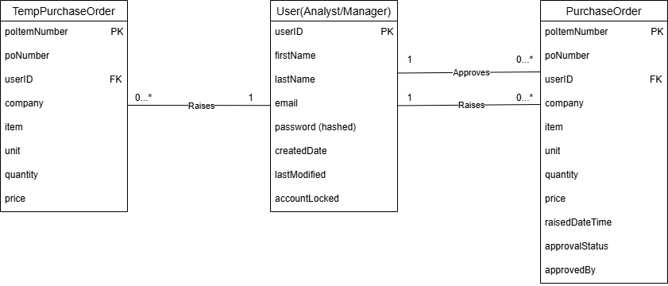
Database Design Diagram – Purchase Order 1.0

Slide 20
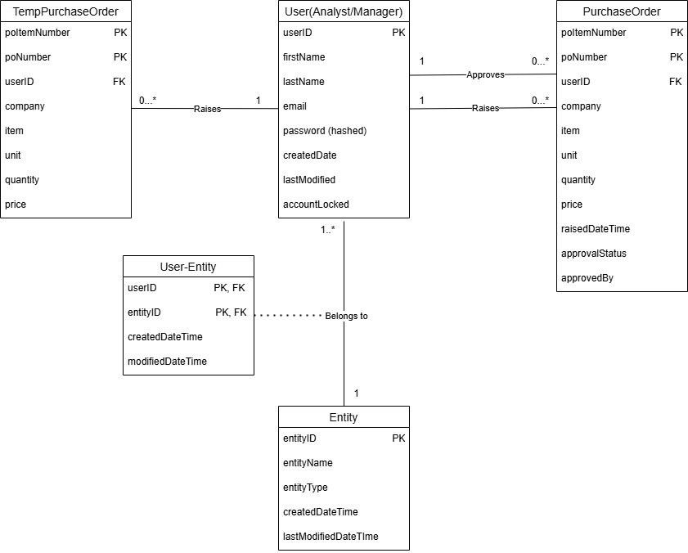
Database Design Diagram – Purchase Order 1.1

Slide 21
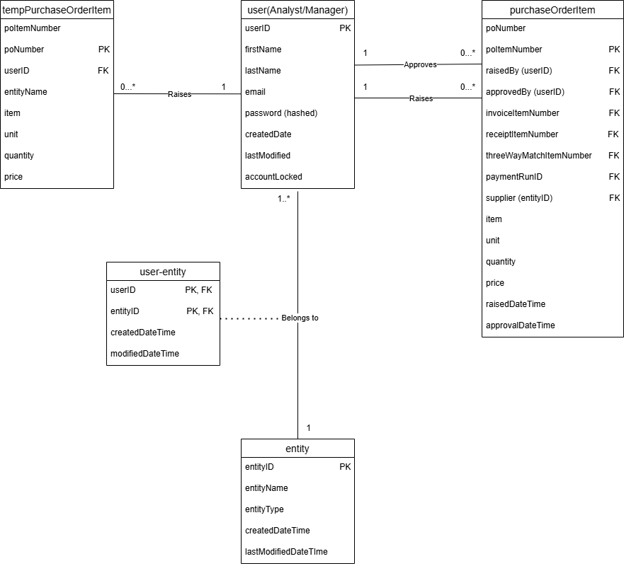
Relational/Conceptual Model– Purchase Order Item 1.2

Slide 22
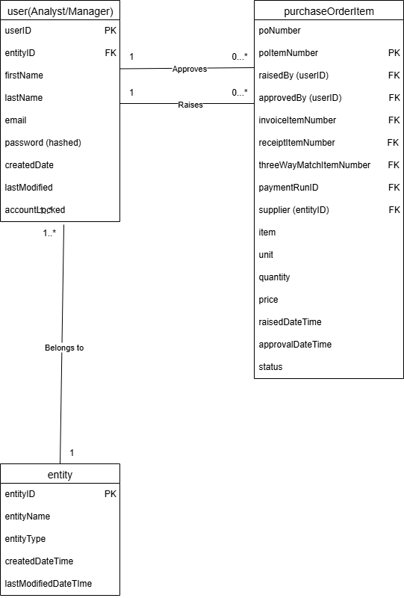
Relational/Conceptual Model– Purchase Order Item 1.3

Slide 23
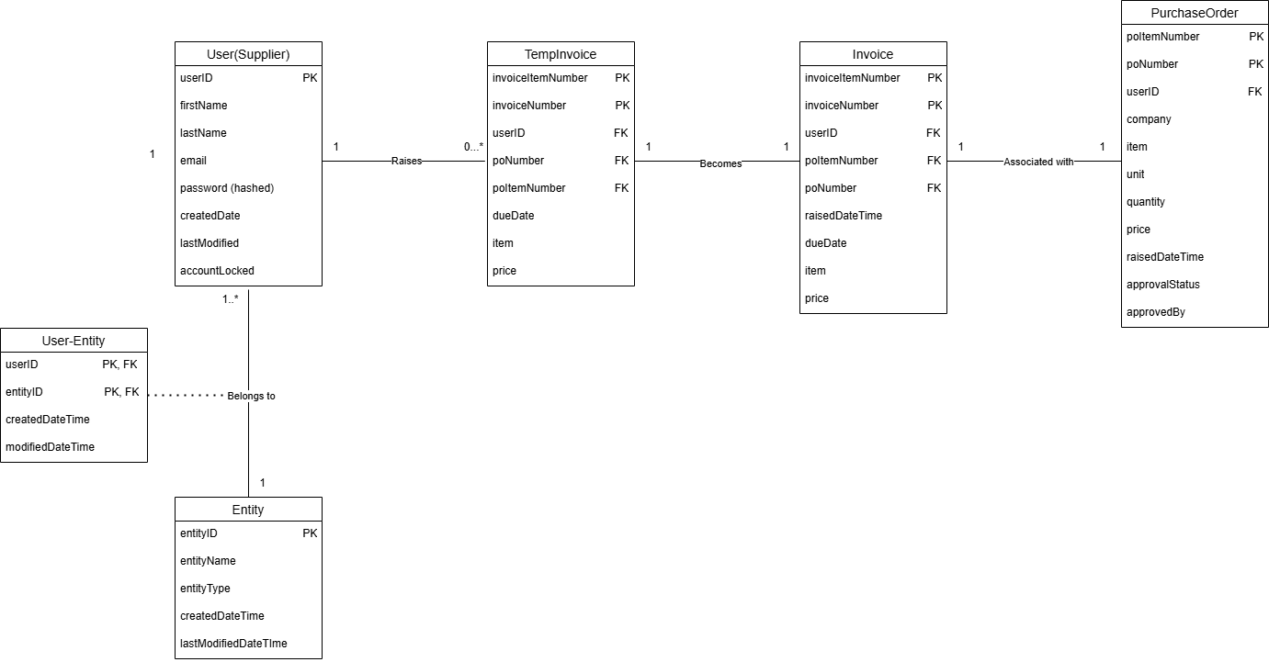
Database Design Diagram – Invoices 1.0

Slide 24
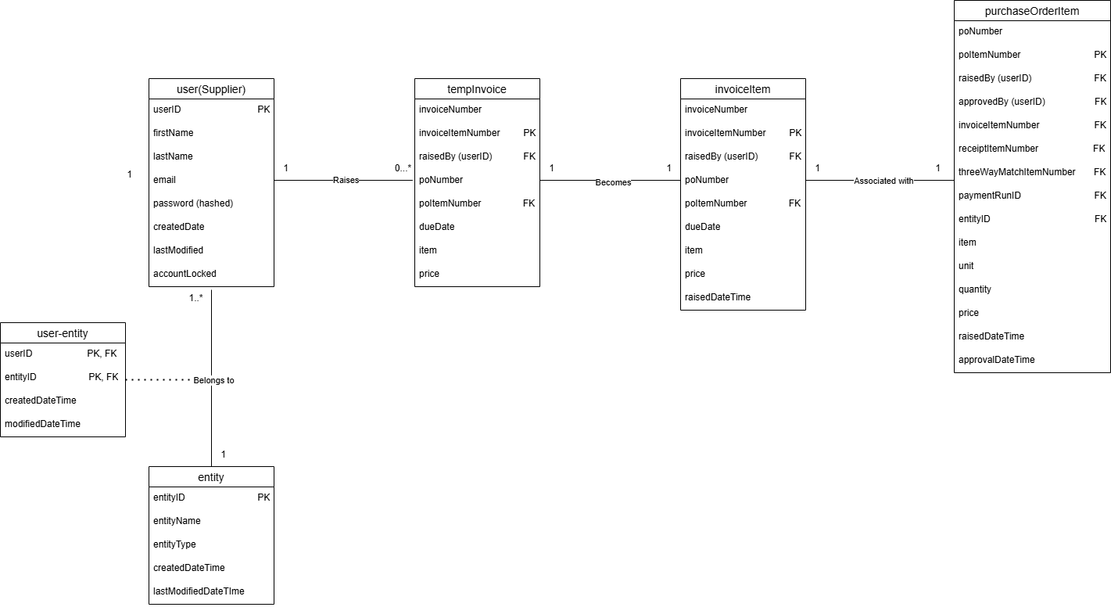
Relational/Conceptual Model – Invoices 1.1

Slide 25
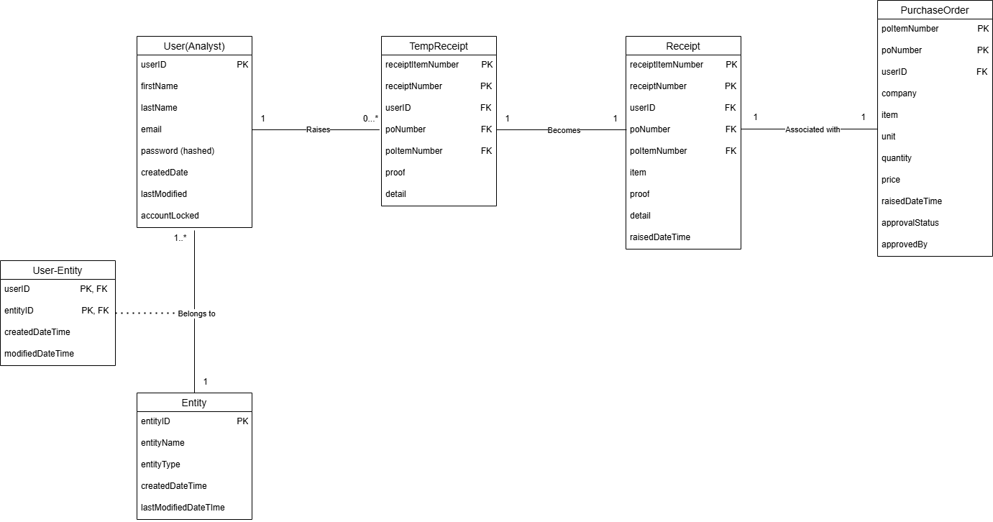
Database Design Diagram – Receipts 1.0

Slide 26

Relational/Conceptual Model – Receipts 1.1

Slide 27
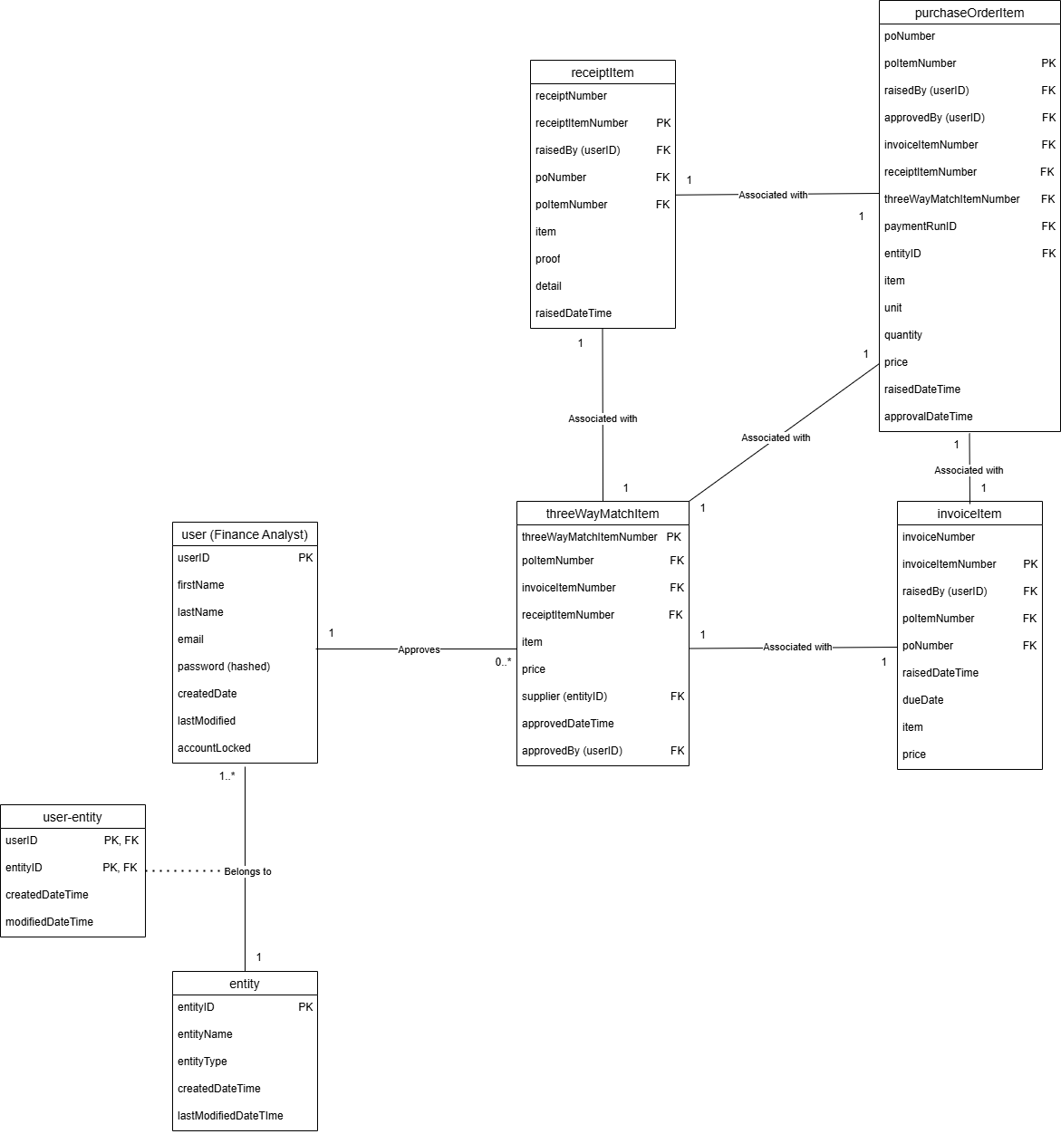
Relational/Conceptual Model – TripleMatching 1.0

Slide 28
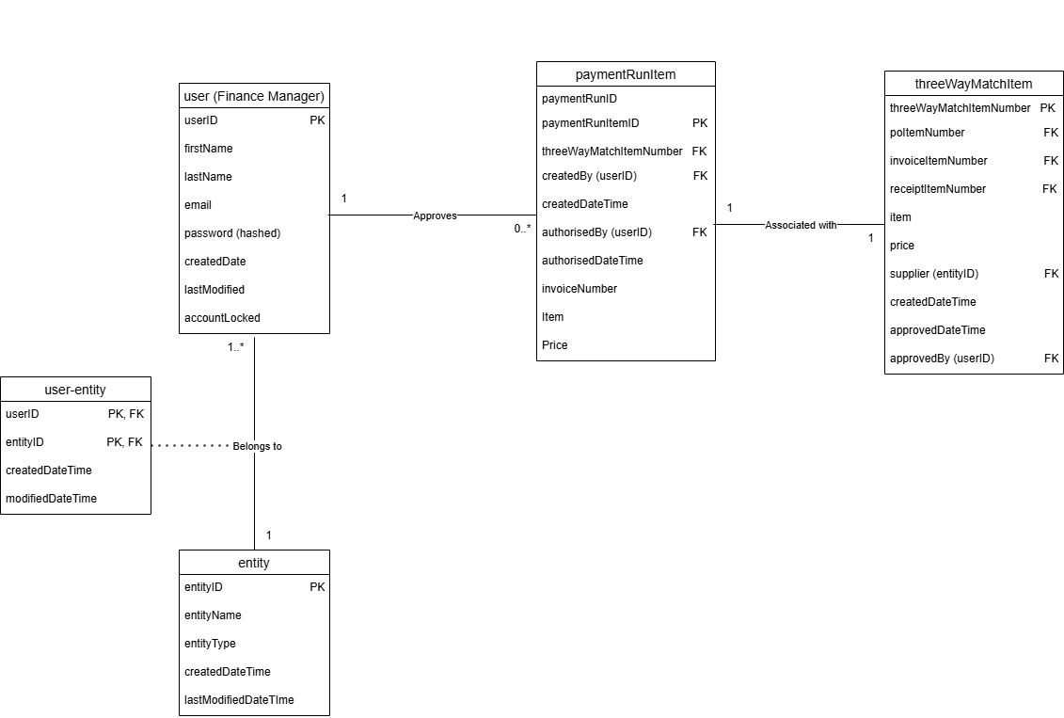
Relational/Conceptual Model – PaymentRuns 1.0

